Slide 1
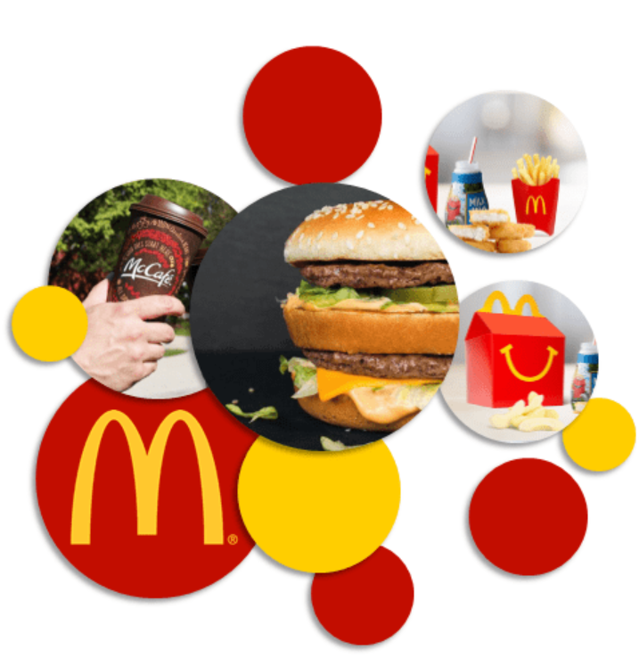

Customized Optimizing McDonald’s meal Application
Programming project
for Advance Programming Spring 2022
Jiaming Huang
Ting Yang
Manunpat Sirijaturaporn
Notes:
Hi, we would like to present a customized optimizing McDonald’s meal application

Slide 2
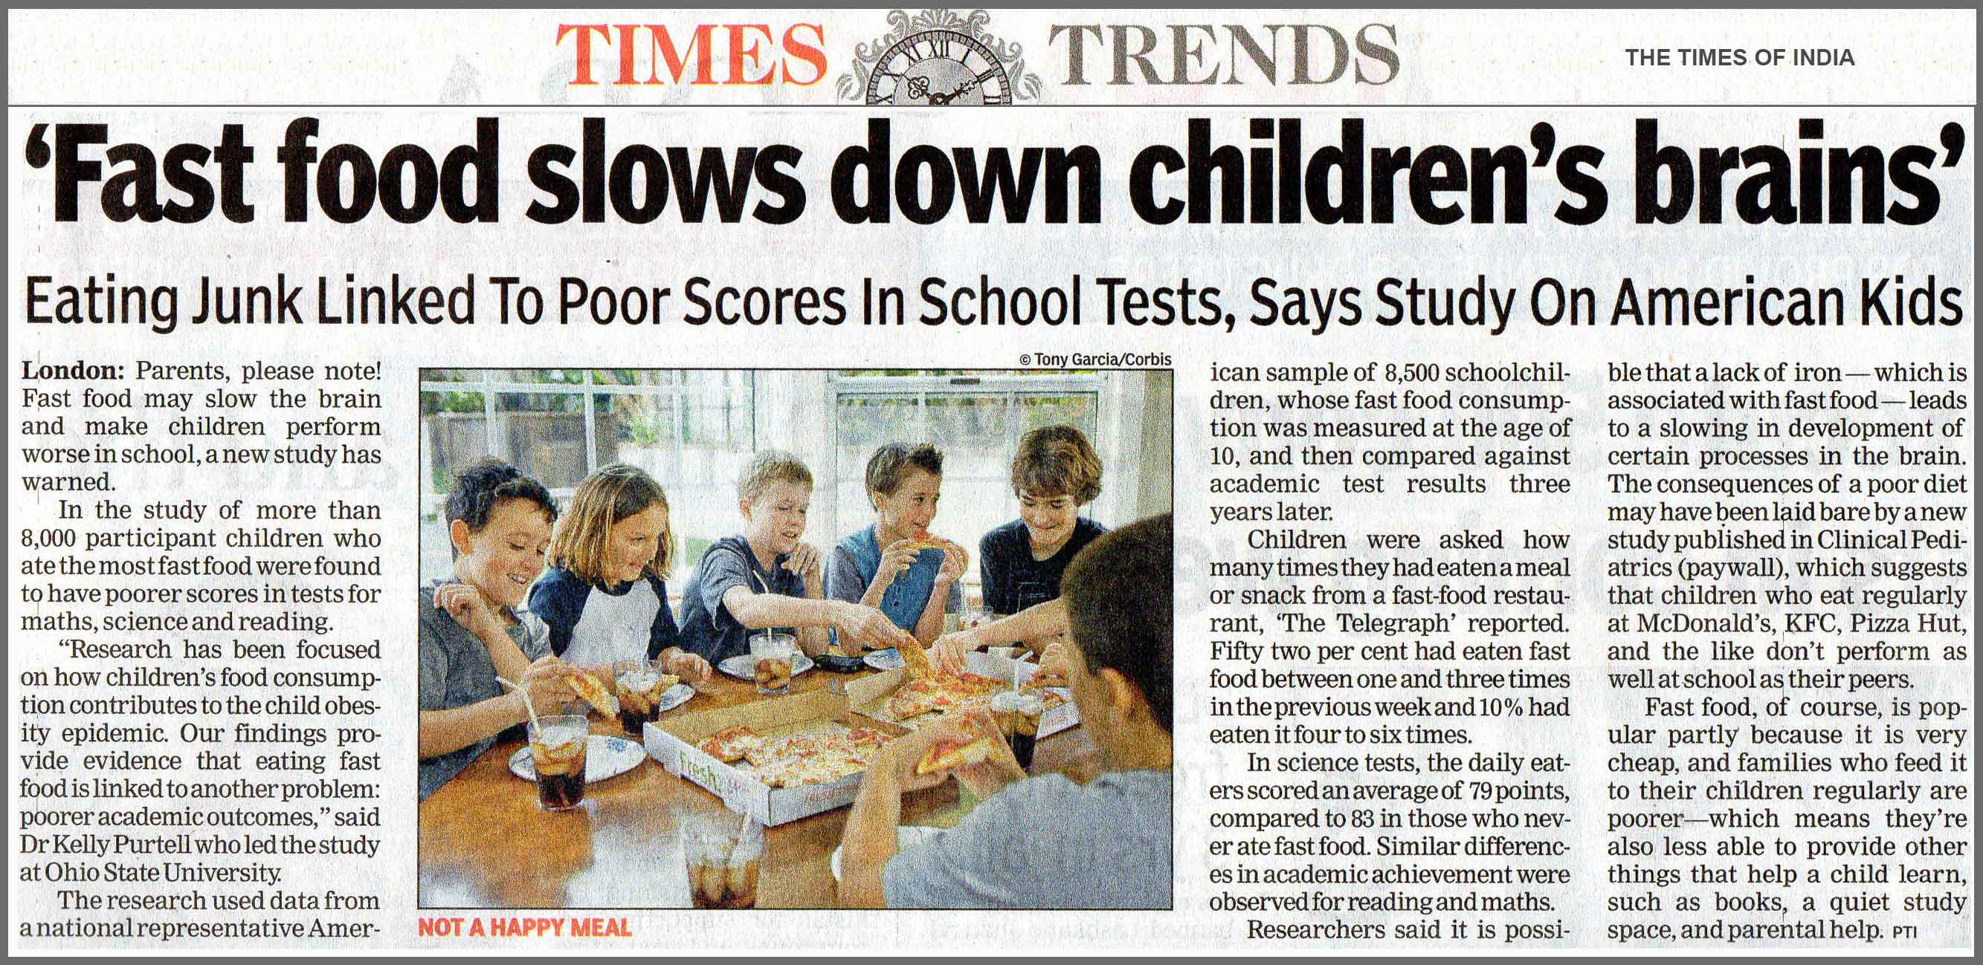
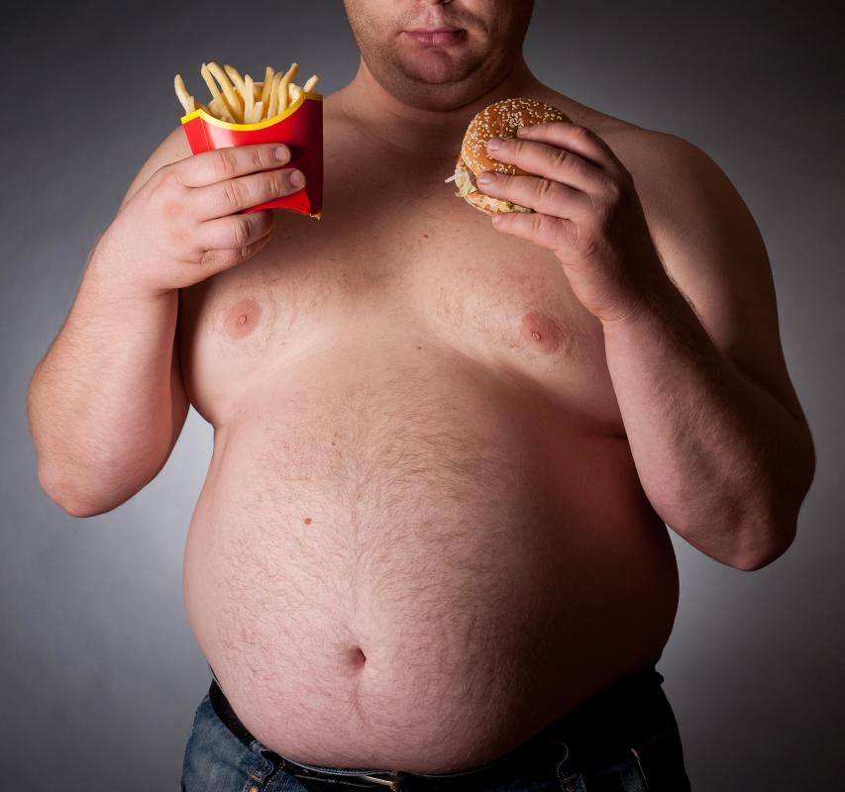
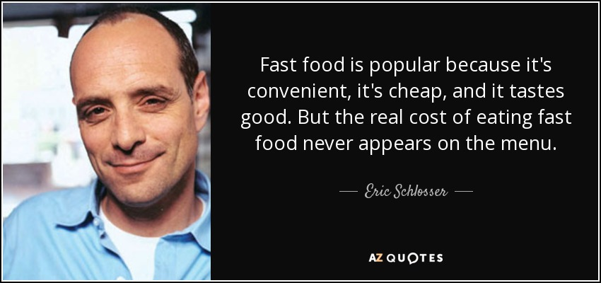
Motivation and Objective
“We aim to optimize McDonald’s intake given the minimum daily nutrition requirement”
Notes:
Speaking of fast food, I’m definitely sure that you have more negative perceptions than positive ones. But we are always feeling right doing the wrong thing that’s why it’s popular.
Although the food got criticized every day, it is cheap, convenient, and tasty!
McDonald’s, which is the leading fast-food chain, grabs our attention. So our study aims to optimize McDonald’s intake given the minimum daily nutrition requirement if we consume it 3 meals a day.

Slide 3
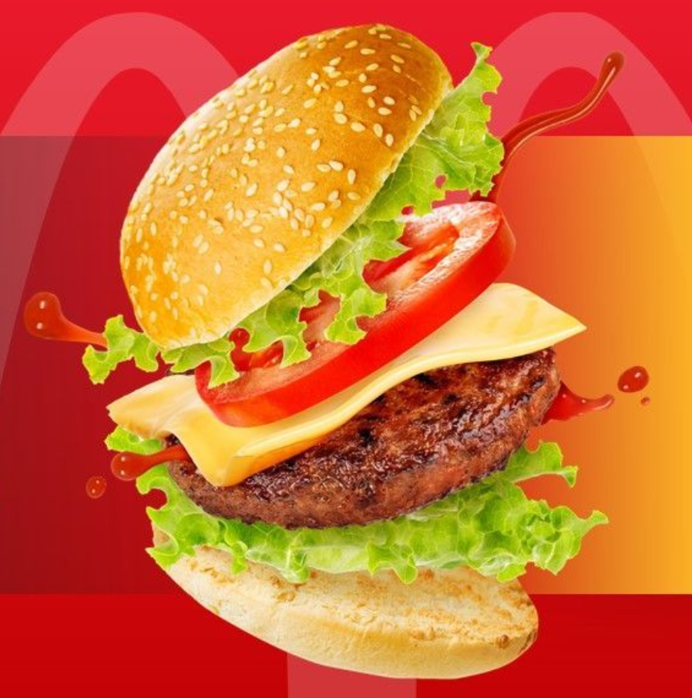

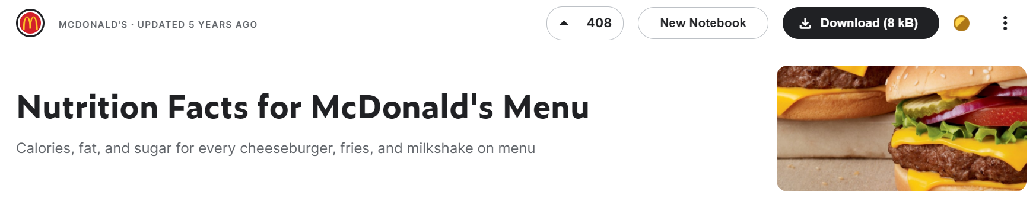
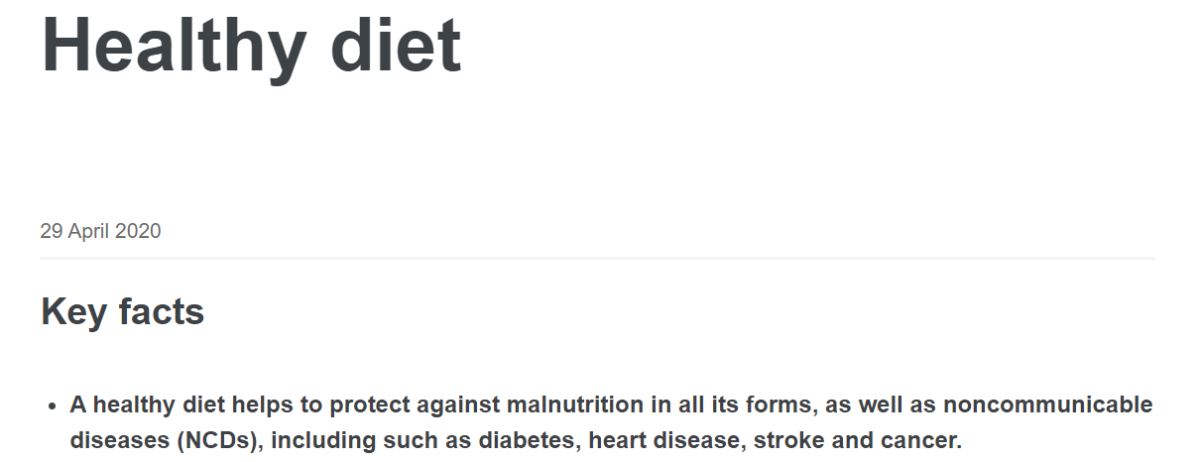

Data preparation
Reference: https://www.kaggle.com/datasets/mcdonalds/nutrition-facts, https://www.who.int/news-room/fact-sheets/detail/healthy-diet
Notes:
We then found the McDonald’s menu in the United States on Kaggle website and found the nutrition requirements per meal each day on the World Health Organization website

Slide 4
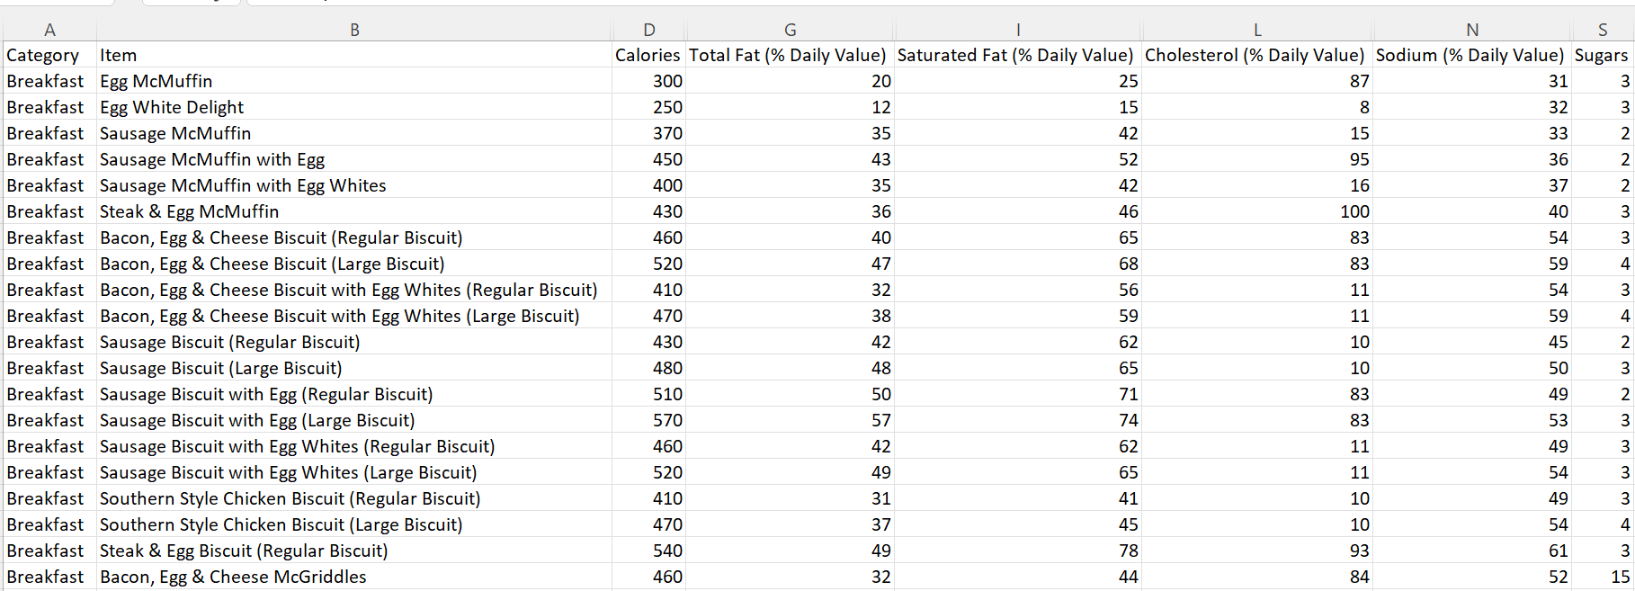

Data preparation
Notes:
McDonald’s menu would be analysed by user individual profiles to provide the optimal consumption suggestions regarding suitable calories, total fat, saturated fat, cholesterol, sodium, and sugars.
For example, from having 1 sausage McMuffin, you will receive 370 calories, 35% of total fat, 42% of saturated fat that you need each day

Slide 5
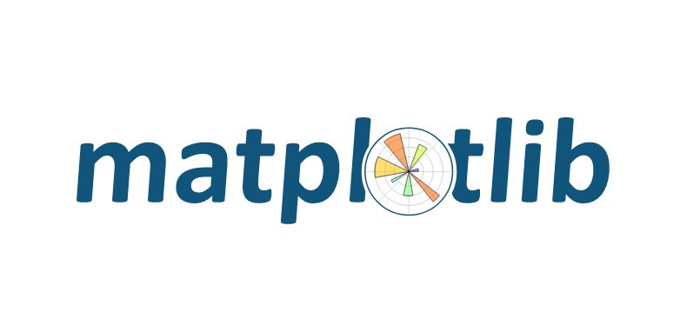




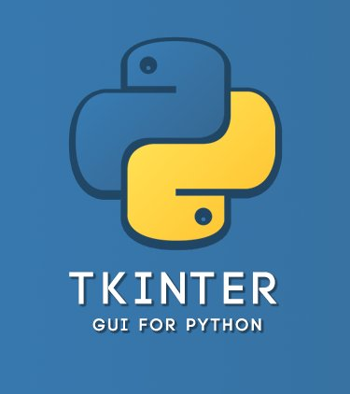

Package preparation
Plotting nutrition each meal
Optimization problem
Interface and visualization
Notes:
These are the packages we applied in building the application.
For setting the optimization problem, we mainly use Google OR tools, particularly ortools.linear_solver, pandas, numpy
For plotting bar charts, matplotlib is applied
And for creating the interfaces, we use tk inter to build visual indicators such as icons and ttk bootstrap to make the interfaces more beautiful.
We also use Python Imaging Library (PIL): for inserting images

